Slide 1

Cyclistic Bike-Share Case Study
Google Data Analytics Capstone Project
Presented by: Bernard Bamidele Aghedo
20/07/2022

Slide 2
Introduction
A bike-share program that features more than 5,800 bicycles and 600 docking stations. Cyclistic sets itself apart by also offering reclining bikes, hand tricycles, and cargo bikes, making bike-share more inclusive to people with disabilities and riders who can’t use a standard two-wheeled bike. The majority of riders opt for traditional bikes; about 8% of riders use the assistive options. Cyclistic users are more likely to ride for leisure, but about 30% use them to commute to work each day.

Slide 3
Stakeholders
Lily Moreno: The director of marketing
Cyclistic marketing analytics team
Cyclistic executive team

Slide 4
Objective
How do annual members and casual riders use Cyclistic bikes differently?

Slide 5
Data Preparation
I used the Cyclistic’s historical trip data to analyze and identify trends. The data has been made available by Motivate International Inc. under this license.
I downloaded the zip files from the above link, extracted the csv files and imported it into google sheets for glimpse of the data set.
The dataset is then imported into R for further analysis

Slide 6
Data Processing
I used R for the data cleaning process.
I read all 26 csv files from April 2019 to April 2022 and binded all into a dataframe: bike_rides
I removed empty columns from the dataframe
I checked and filtered Test stations
Columns were created for hours, weekday, month and year of rides
Graphical representations were made with its respective correlations

Slide 7
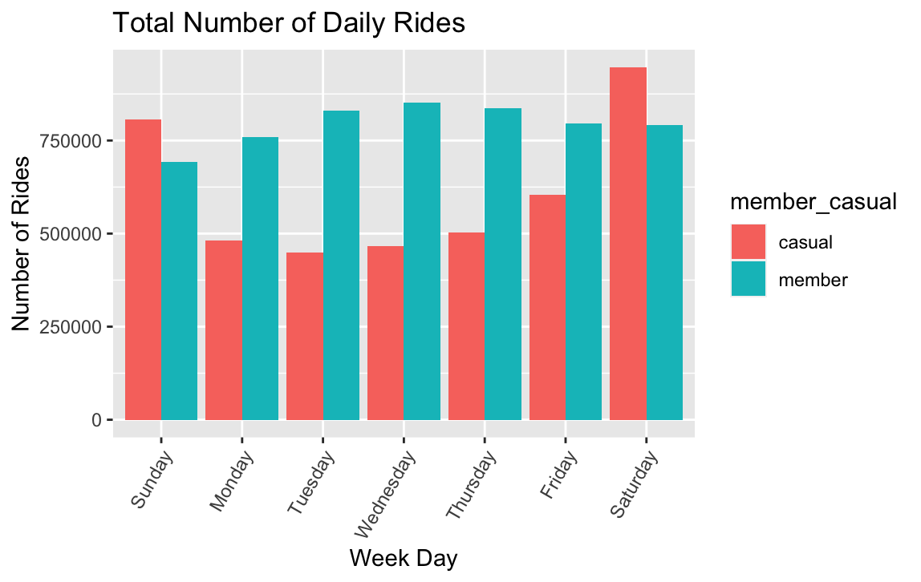
Daily Membership Rides

Slide 8
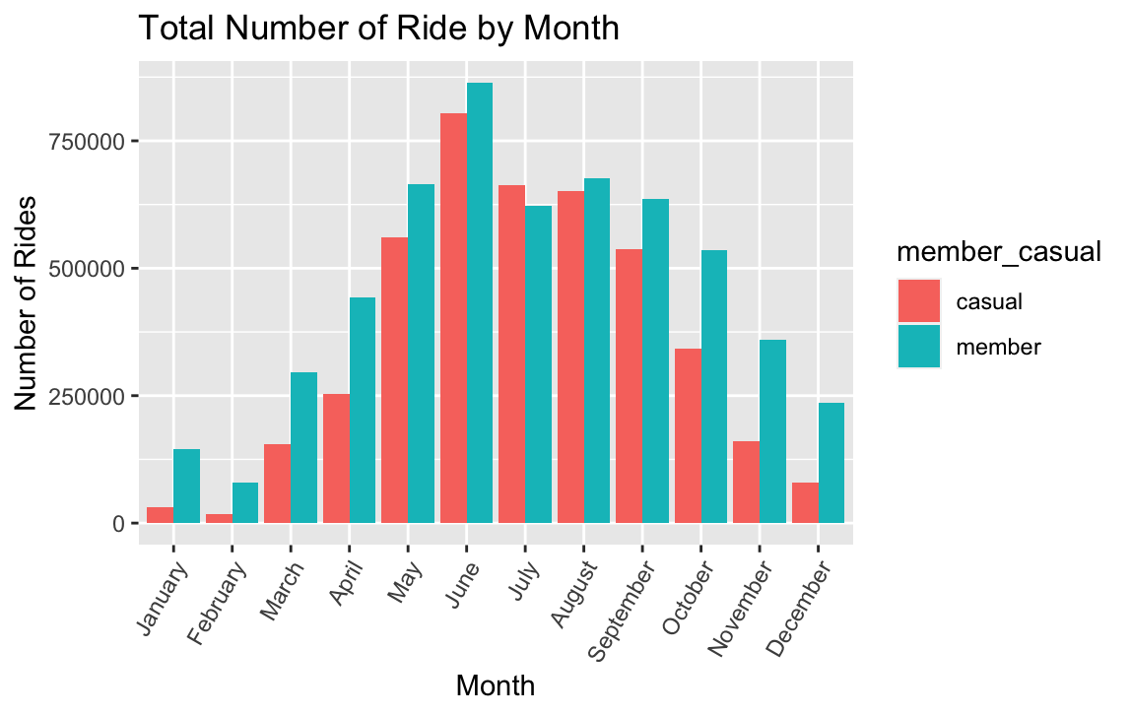
Monthly Membership Rides

Slide 9
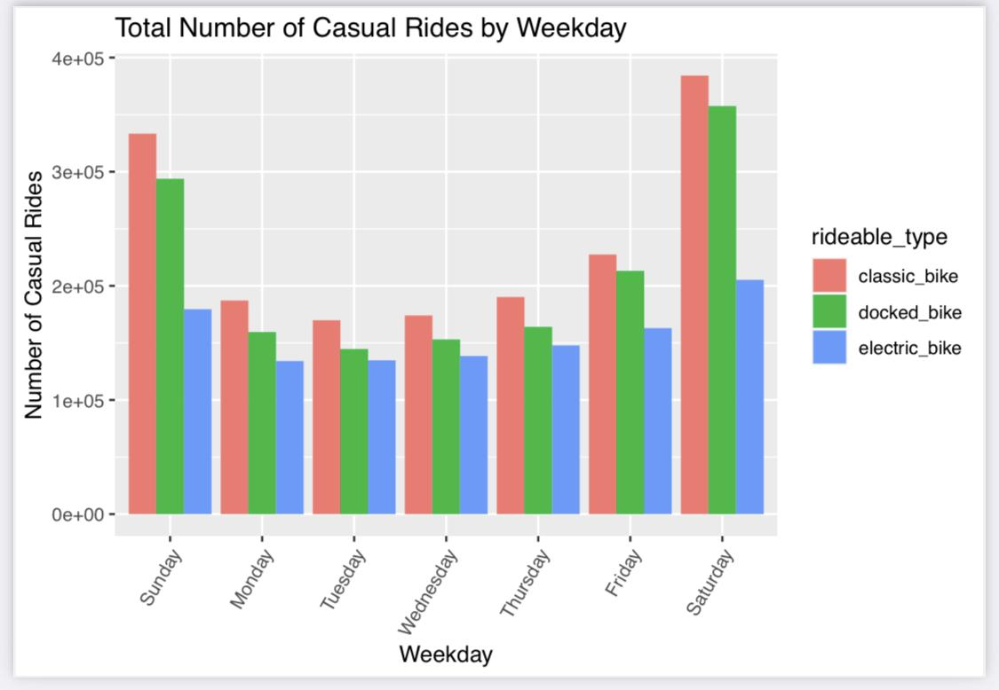
Casual Riders Type by Weekday

Slide 10
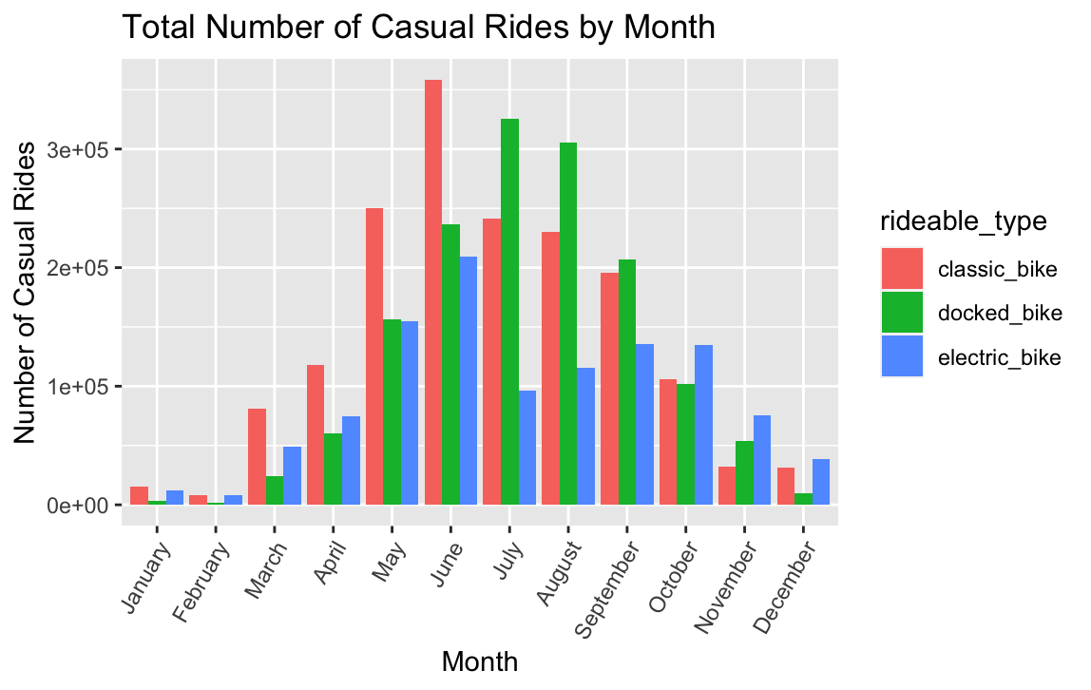
Casual Riders Type by Month

Slide 11
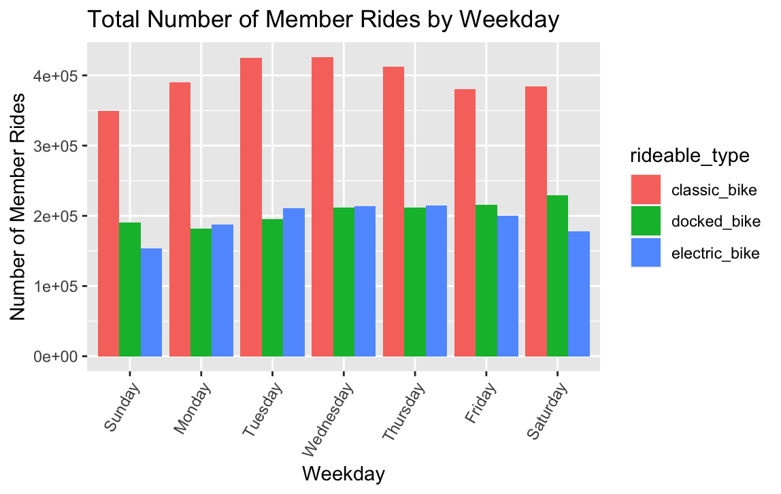
Member Riders Type by Weekday

Slide 12
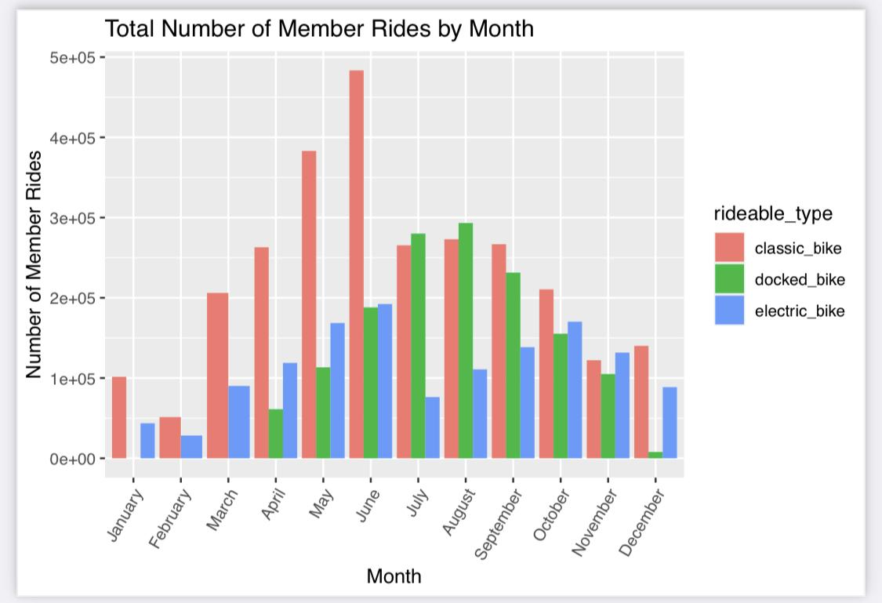
Member Riders Type by Month

Slide 13
Conclusion
Classic bike is being used the most by both casual and member riders with most rides at the first half of the year, Docked bike is the next used bikes to classic bike
Member riders have more rides during the week which is between Mondays to Fridays While Casual have more rides during weekends which is Saturdays and Sundays
Rides around the mid months have relatively high number of rides with June being the highest

Slide 14
Business Suggestions
Casual Riders have more rides during weekends compared to other days of the week. Field interventions such as digital marketing awareness in each stations can be created as many casual riders will be present
Classic bikes are the most used type of rideable bikes used by both membership and casual riders, followed by Docked bikes. The marketing analytics team can focus on more of the Classic and Docked bike types due to recent riders choices

